Slide 1
Medical Supply Chain DApp
Ranjit Singh Bisht
Sai Krishna Kaushik Manchiraju

Slide 2
PROBLEM STATEMENT
Drug Counterfeiting is one of the most dangerous and major issues faced in today’s world.
According to World Health Organization(WHO),
An estimated 1 in 10 medications in developing and under developed countries are either falsified or substandard.
At least a 100,000 to 1 million people die every year due to counterfeit drugs.
It is estimated that at least 72,000 children die of pneumonia and 69,000 people die of malaria each year as a result of falsified or substandard treatments.
In developed countries like the U.S., the government has taken necessary measures to protect medications, but at a cost of 27 billion dollars a year.

Slide 3
OBJECTIVE
The objective of the project is to build a global communication network for protecting the drug distribution supply chain and investigating drug counterfeit crimes.
We want to make sure the drug consumed by the patients are the right drugs.
And also to make sure that every user of our application is a genuine user with a valid identity.

Slide 4
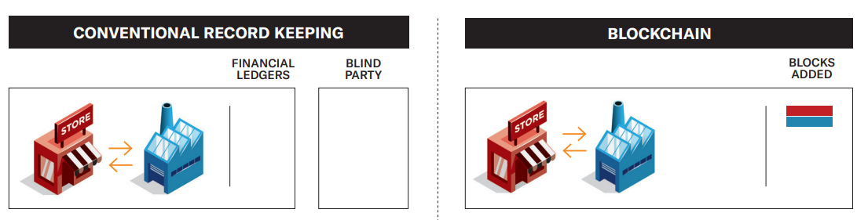
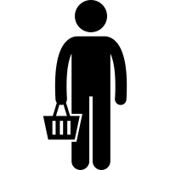
Conventional vs. Blockchain Systems

Slide 5
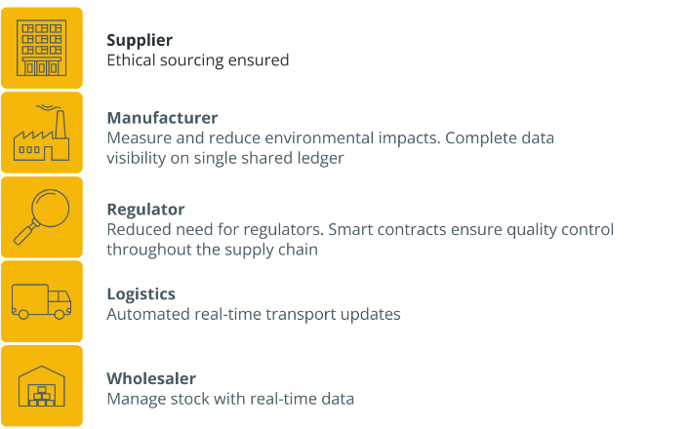
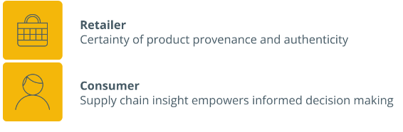
Benefits of Leveraging BlockChain

Slide 6
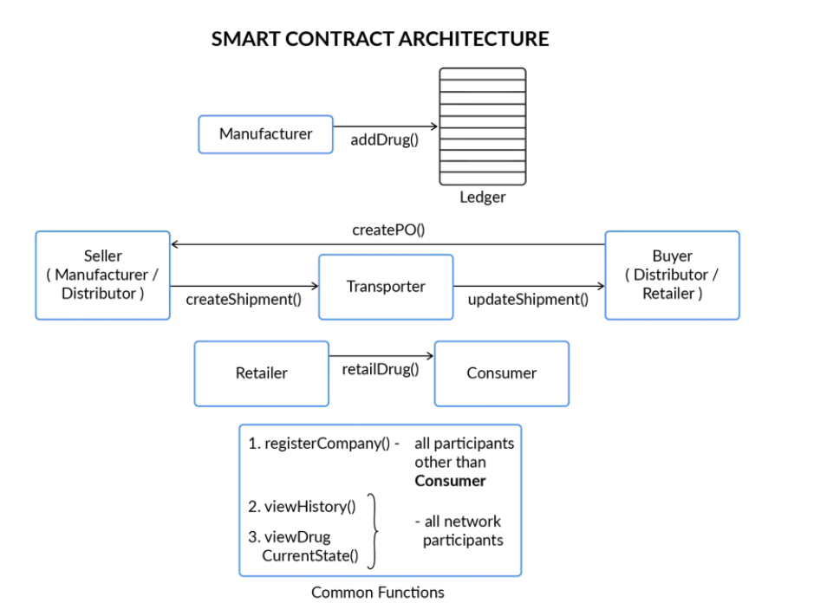
Smart Contract Architecture

Slide 7
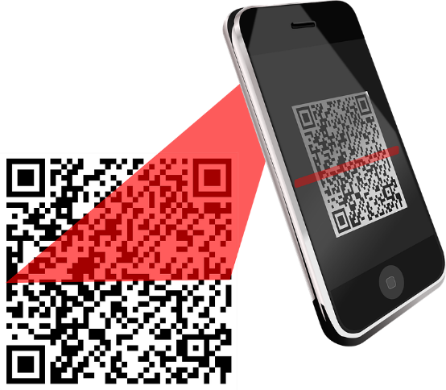
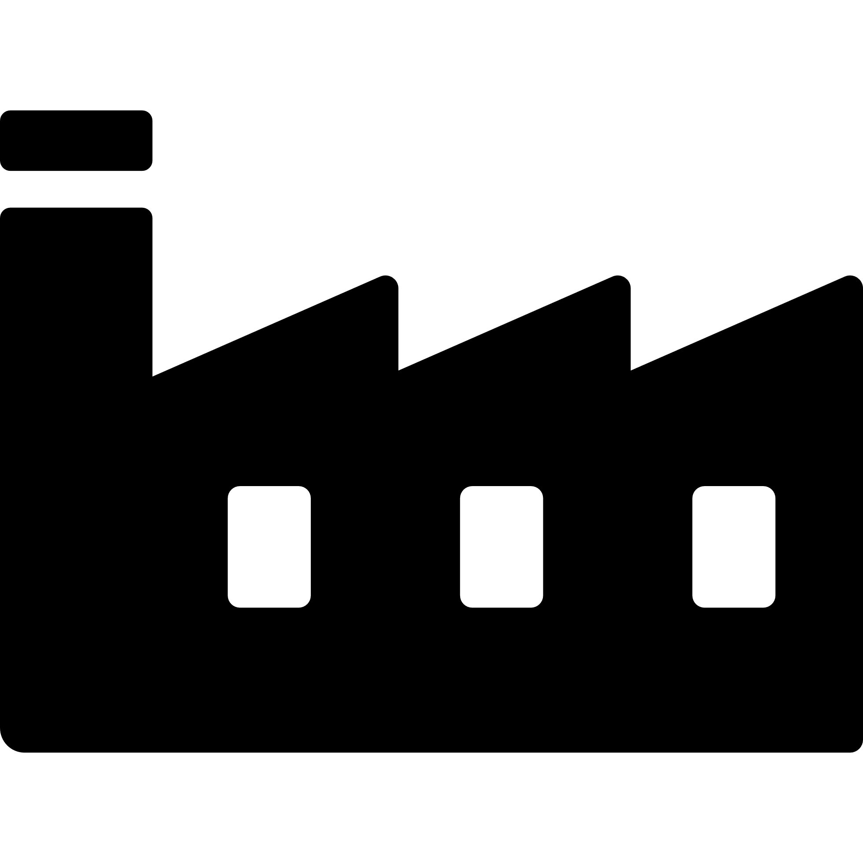
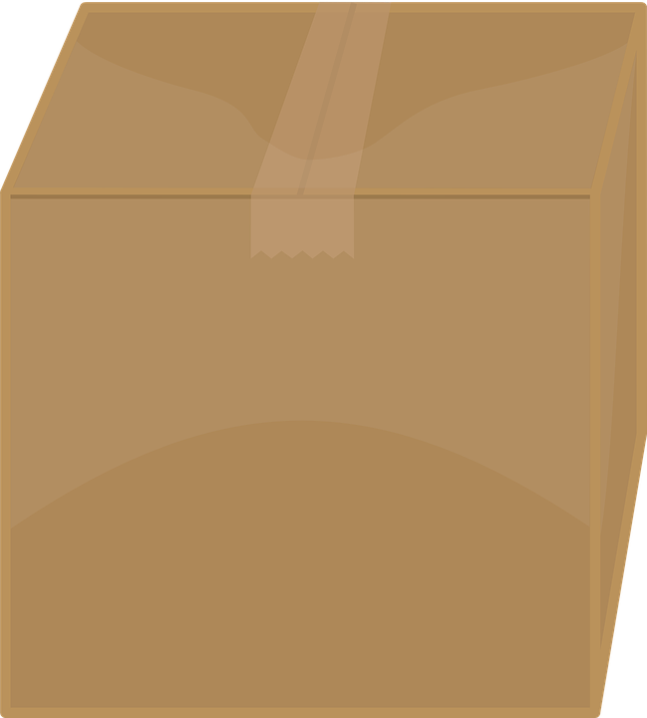
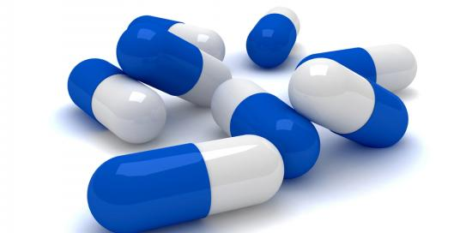
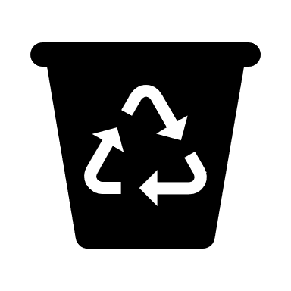
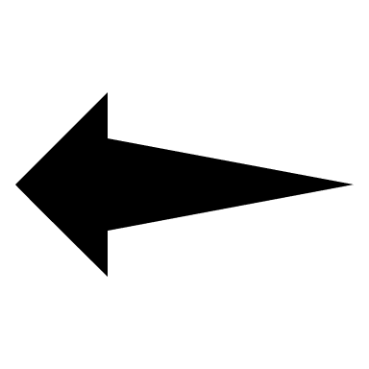
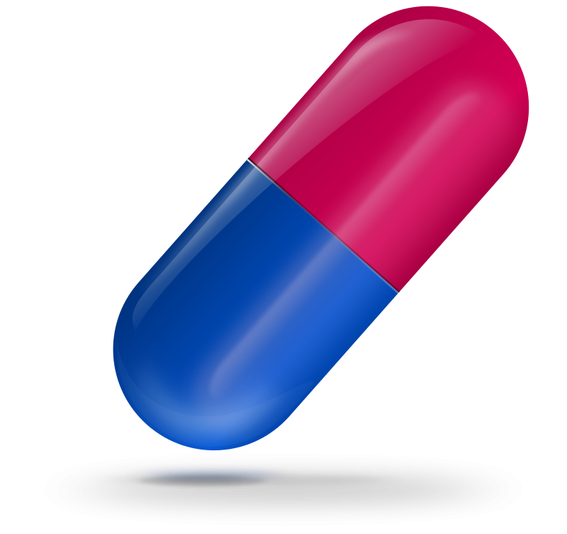

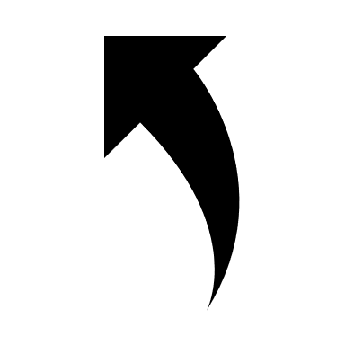

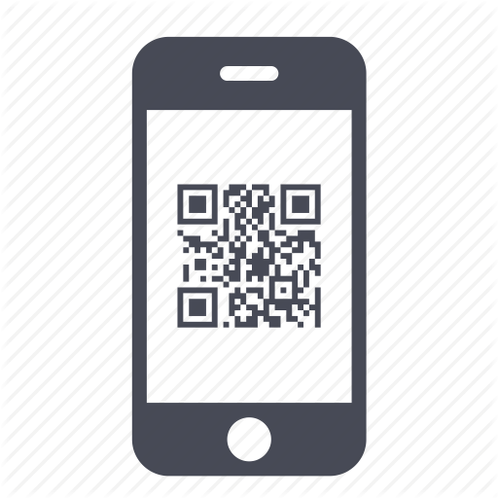
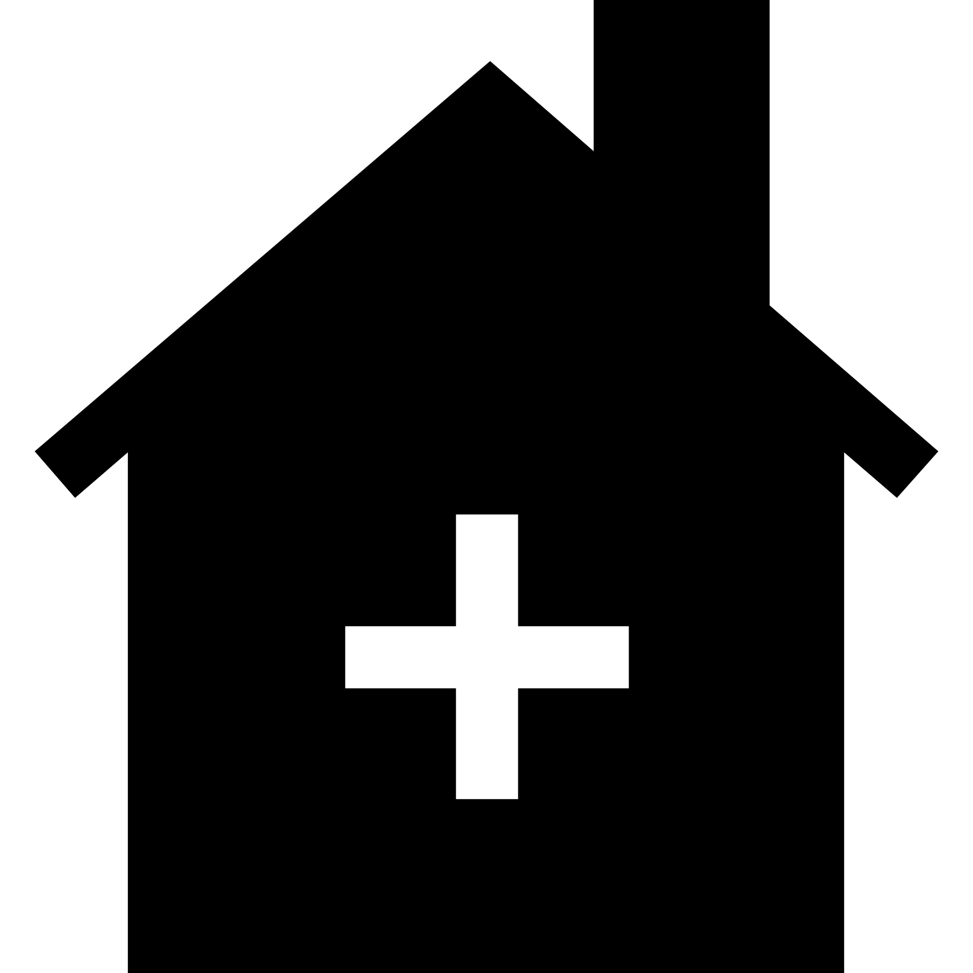

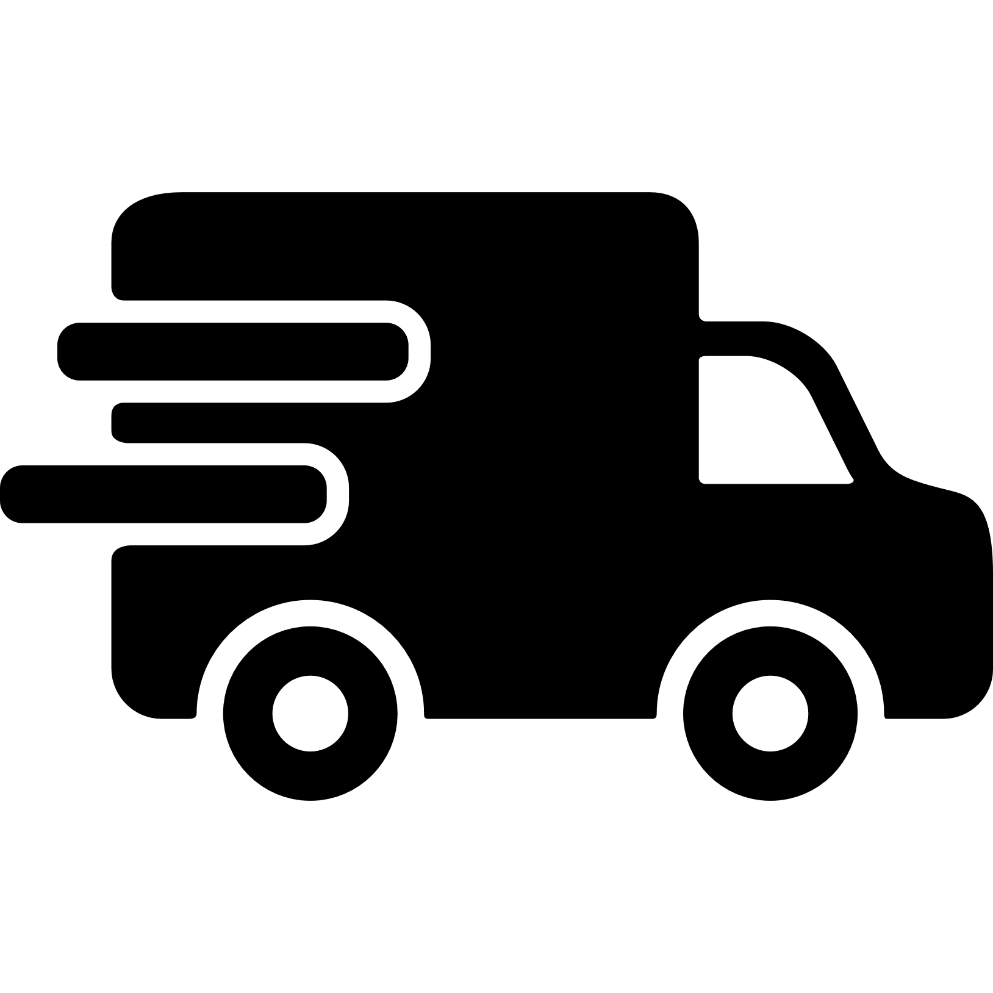
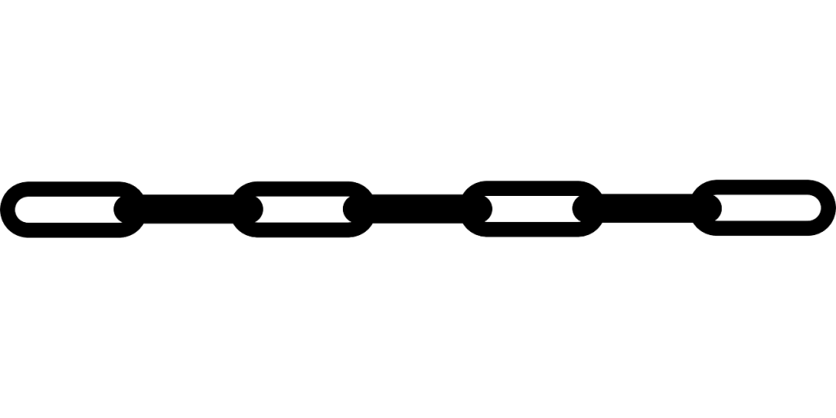
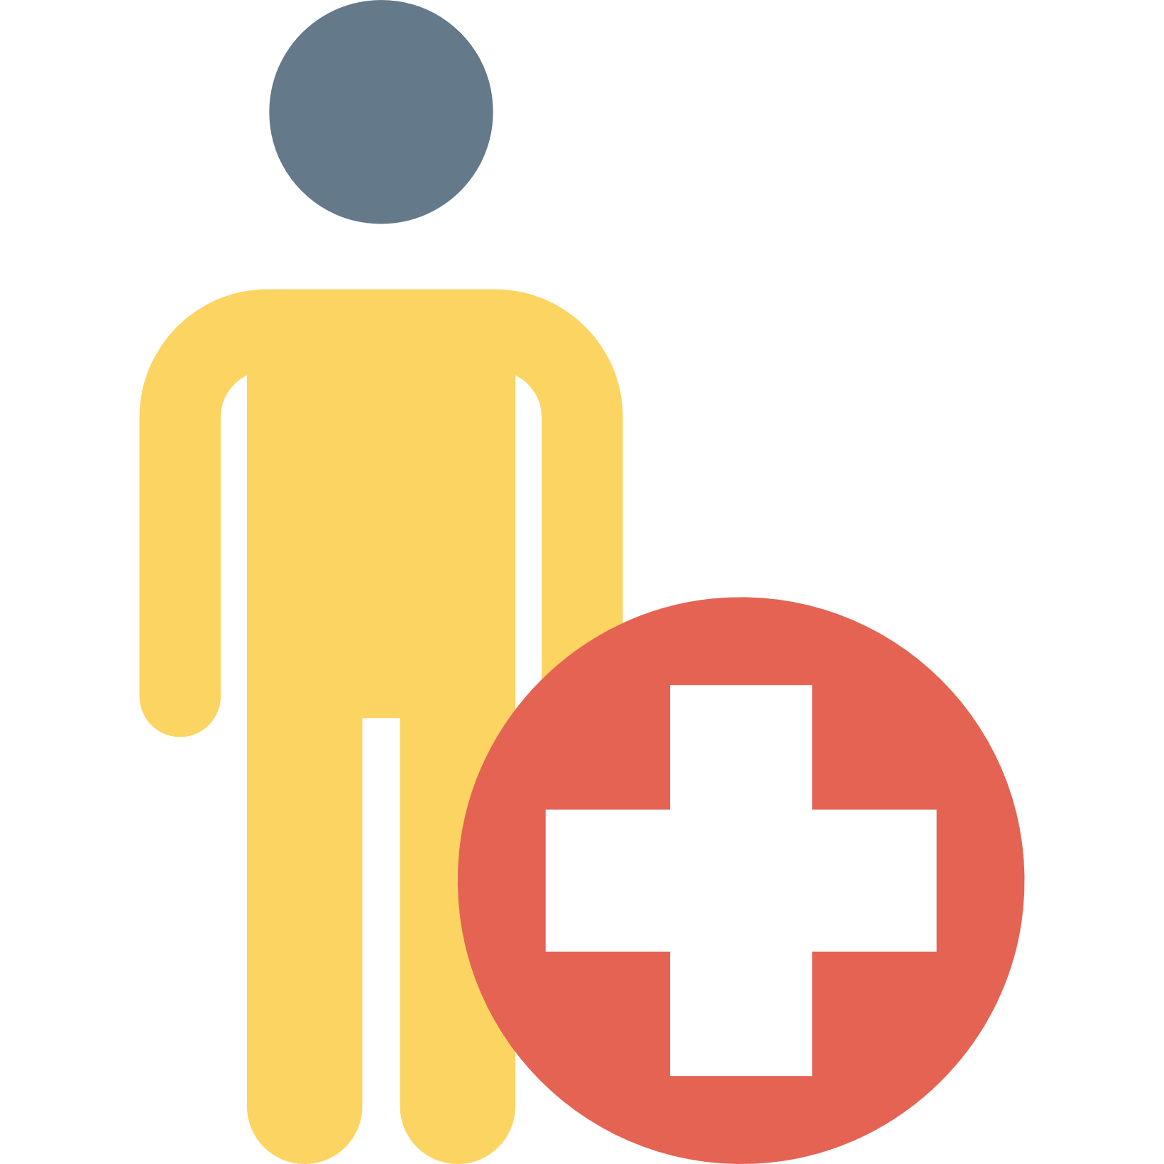
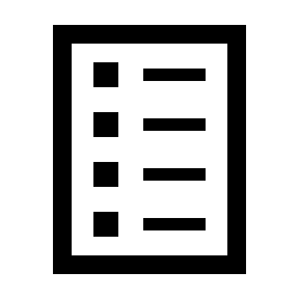
Medication Movement
Manufactures
Medication ID
Verified Manufacturer
Suspicious Medications
Fake Drug
Fake Drug
Verified Pharmacy
Verified Distributor
Verified Manufacturer
Valid Medications
Patient
Pharmacy Inventory
Distributor Inventory
Manufacturer Inventory
BLOCKCHAIN

Slide 8
Demo

Slide 9

TECHNOLOGIES USED
Frontend – HTML, CSS and JavaScript
Solidity - Solidity is a contract-oriented, high-level language for implementing smart contracts.
Web3 - This is the Ethereum compatible JavaScript API which implements the Generic JSON RPC spec.
Backend – PHP and MySQL for database. XAMPP for database and web server

Slide 10
Conclusion
We have successfully been able to solve
Identity issue. All players of the supply chain are genuine and verified.
The transactions are signed on the mobile phones.
Secure movement of medications using Blockchain.
Reduce the number of deaths caused due to drug counterfeiting by a very huge margin.
We can eradicate the illegal market of drug supply chain in the society.

